Slide 1
A2: ETL and SOCIAL MEDIA data analysis
Tutorial

Slide 2
Overview
Extracting data from social media platforms
Learn extract, transform and loading process
Advanced data management process using NoSQL DB
Sentiment analysis and basic machine learning techniques

Slide 3
Data extraction from online services
How data could be extracted from different web resources such as websites, online databases and services?
The majority of data is in HTML format which is designed for semi-structured data.
Data delivery through via Application Programming Interface (APIs) and Representational State Transfer (REST).

Slide 4
Extract, transform and load Process
ETL is a process in data warehousing responsible for pulling data out of the source systems and placing it into a data warehouse.
extracting the data from source systems data from different source systems is converted into one consolidated data warehouse format which is ready for transformation processing.
transforming the data may involve the following tasks:
applying business rules (so-called derivations, e.g., calculating new measures and dimensions),
cleaning,
filtering,
splitting a column into multiple columns and vice versa,
joining together data from multiple sources (e.g., lookup, merge),
transposing rows and columns,
applying any kind of simple or complex data validation
loading the data into a data warehouse or data repository other reporting applications

Slide 5
NoSQL
Data can be stored in a schema-less or free-form fashion.
Four common models of NoSQL:
Document databases (e.g. CouchDB, MongoDB)
Key-value stores (e.g. Redis, Riak)
Wide column stores (e.g. HBase, Cassandra)
Graph databases (e.g. Neo4j)

Slide 6
Elastic search As nosql
Article about ElasticSearch as a NoSQL db
https://www.elastic.co/blog/found-elasticsearch-as-nosql
In production usually used with logstash in addition to other DB system.
Provides “smart” and fast search capabilities.

Slide 7
Sentiment analysis
Sentiment analysis – otherwise known as opinion mining.
Determining the emotional tone behind a series of words, used to gain an understanding of the attitudes, opinions and emotions expressed within an online mention.
Overview of the wider public opinion behind certain topics.
Example API implementation:
https://www.paralleldots.com/sentiment-analysis

Slide 8
Assignment 2 tasks

Slide 9
Prerequisites
Create new EC2 instance and install ElasticSearch as in A1
Create a new account on Twitter (twitter.com)

Slide 10
Prerequisites
Ubuntu 16.04, Debian 8, and other versions of Debian Linux ship with both Python 3 and Python 2 pre-installed. Check:
python3 –V
Install pip package manager:
sudo apt-get install -y python3-pip
Install tweepy:
pip3 install tweepy

Slide 11
Tweepy – working with twitter API

Slide 12
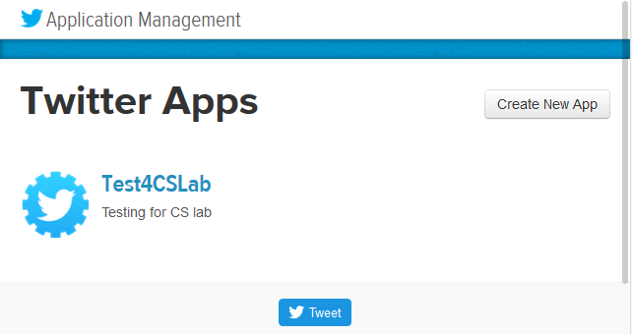
Creating TWITTER APP
Once your Twitter account is activated, visit apps.twitter.com
Create New App.

Slide 13
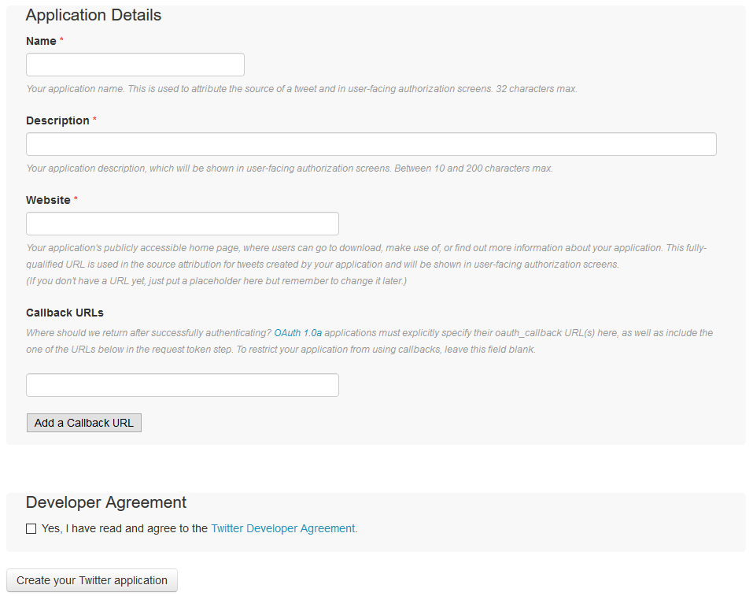
Creating TWITTER APP

Slide 14
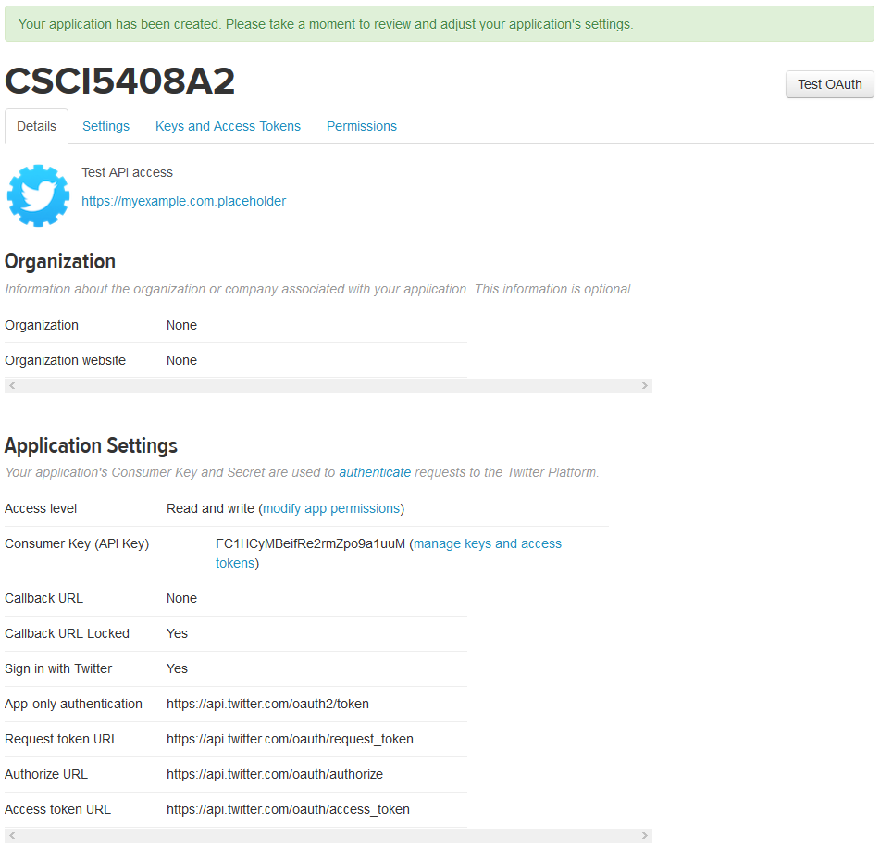
Creating TWITTER APP

Slide 15
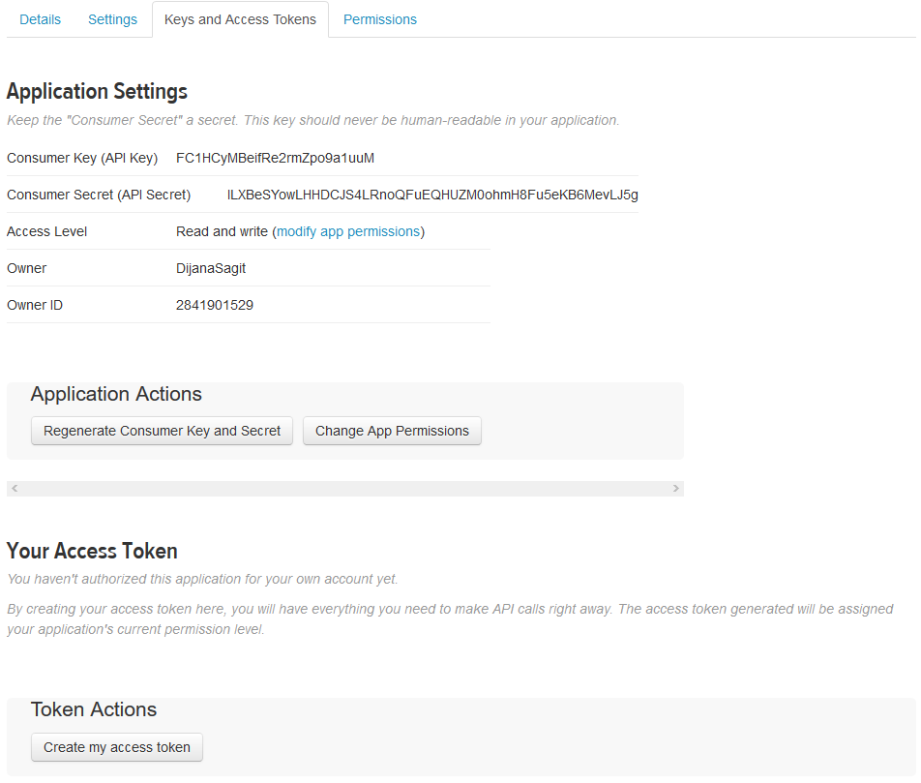
Creating TWITTER APP
From this page you will need the consumer key and consumer secret.
On the bottom click Create my access token.

Slide 16
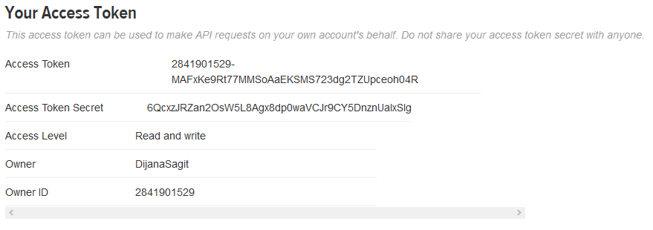
Creating TWITTER APP
Once created, you will use access token and access token secret to connect.

Slide 17
Creating SAMPLE APP in PYTHON
Import tweepy and copy the credentials
import tweepy
import time
import json
# Twitter API credentials
consumer_key = "FC1…uM"
consumer_secret = "lLXBeSY…MevLJ5g"
access_key = "28419…oh04R"
access_secret = "6QcxzJR…UalxSlg"

Slide 18
Oauth
Establish connection using OAuth:
auth = tweepy.OAuthHandler(consumer_key, consumer_secret)
auth.set_access_token(access_key, access_secret)
api = tweepy.API(auth)

Slide 19
Get data from profile
def get_profile(screen_name):
api = tweepy.API(auth)
try:
#https://dev.twitter.com/rest/reference/get/users/show describes get_user
user_profile = api.get_user(screen_name)
except tweepy.error.TweepError as e:
user_profile = json.loads(e.response.text)
return user_profile

Slide 20
Get Trending topics
def get_trends(location_id):
api = tweepy.API(auth)
try:
#https://developer.twitter.com/en/docs/trends/trends-for-location/api-reference/get-trends-place.html
trends = api.trends_place(location_id)
except tweepy.error.TweepError as e:
trends = json.loads(e.response.text)
return trends

Slide 21
Standard search query
To access standard search, use this:
API.search(q[, lang][, locale][, rpp][, page][, since_id][, geocode][, show_user])
More on search queries:
https://developer.twitter.com/en/docs/tweets/rules-and-filtering/overview/standard-operators.html

Slide 22
example
def get_tweets(query):
api = tweepy.API(auth)
try:
tweets = api.search(query)
except tweepy.error.TweepError as e:
tweets = [json.loads(e.response.text)]
return tweets
tw = get_tweets("#HanSolo")

Slide 23
Saving to CSV
queries = ["#HanSolo", "\"Nova Scotia\"","@Windows","#realDonaldTrump"]
with open ('tweets.csv', 'w') as outfile:
writer = csv.writer(outfile)
writer.writerow(['id','user','created_at','text'])
for query in queries:
t = get_tweets(query)
for tweet in t:
writer.writerow([tweet.id_str,tweet.user.screen_name,tweet.created_at,tweet.text])

Slide 24
Lexicon based classification

Slide 25
lexicons
SentiWordNet:
http://sentiwordnet.isti.cnr.it/
SocialSent:
https://github.com/williamleif/socialsent
SentiWords:
https://hlt-nlp.fbk.eu/technologies/sentiwords
WordStat:
https://provalisresearch.com/products/content-analysis-software/wordstat-dictionary/sentiment-dictionaries/
And more:
https://www.god-helmet.com/wp/whissel-dictionary-of-affect/index.htm

Slide 26
Python elasticsearch api

Slide 27
Elasticsearch python library
elasticsearch-dsl is a high-level library
Built on top of the official low-level client (elasticsearch-py)
We will use elasticsearch-py for bulk insert.
Documentation on elasticsearch-dsl:
https://elasticsearch-dsl.readthedocs.io/en/latest/

Slide 28
Low level vs high level
Low level
from elasticsearch import Elasticsearch
client = Elasticsearch()
response = client.search(
index="sentiments",
body={
"query": {
"term": {"tweet": "feliz"}
}
}
)
for hit in response['hits']['hits']:
print(hit['_score’], hit['_source']['tweet'])
High level
from elasticsearch import Elasticsearch
from elasticsearch_dsl import Search
client = Elasticsearch()
s = Search(using=client, index="sentiments")
.query("term", tweet="feliz")
response = s.execute()
for hit in response:
print(hit.meta.score, hit.tweet)

Slide 29
Insert with high level
Create a class which describes a document
from datetime import datetime
from elasticsearch_dsl import DocType, Date, Integer, Keyword, Text, connections
# Define a default Elasticsearch client
connections.create_connection(hosts=['localhost'])
class Tweet(DocType):
user = Text(analyzer='snowball', fields={'raw': Keyword()})
tweet = Text(analyzer='snowball')
hashtags = Keyword()
created_at = Date()
lines = Integer()
class Meta:
index = 'tweets2'
def save(self, ** kwargs):
self.lines = len(self.tweet.split())
self.hashtags = [tag for tag in
self.tweet.split()
if tag.startswith("#")]
return super(Tweet, self).save(** kwargs)
def how_old(self):
return datetime.now() - self.created_at

Slide 30
GET with high level
# create the mappings in elasticsearch
Tweet.init()
# create and save a a tweet
tweet = Tweet(meta={'id': 3}, user='user_1')
tweet.tweet = ''' Not so old tweet. #tweet '''
tweet.created_at = datetime.now()
tweet.save()
tweet = Tweet.get(id=3)
print(tweet.how_old())
print(tweet.to_dict())

Slide 31
BULK INSERT with low level
from datetime import datetime
from elasticsearch import Elasticsearch
from elasticsearch import helpers
es = Elasticsearch() # Define a default Elasticsearch client
actions = [ { "_index": “dummytweets", "_type": “tweet", "_id": j,
"_source": {
“tweet": "data" + str(j),
“created_at": datetime.now()} }
for j in range(0, 10) ]
helpers.bulk(es, actions)

Slide 32
Useful references
Twitter API docs:
https://developer.twitter.com/en/docs
Tweepy docs:
http://docs.tweepy.org/en/v3.5.0/getting_started.html
ElasticSearch-dsl Python docs:
https://elasticsearch-dsl.readthedocs.io/en/latest/

